Slide 1
Assignment 3: The Professional Development Reflection
INF20028: Professional Capabilities for a Digital World
S M Ragib Rezwan (103172423)

Slide 2
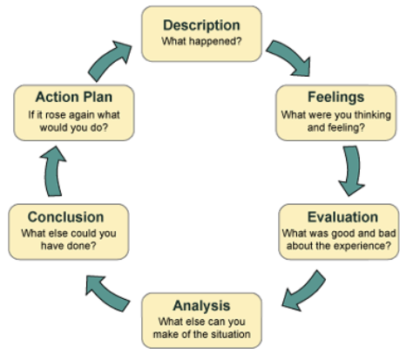
Gibbs Reflective Cycle

Slide 3
Privacy by Design
Built into design and architecture of information systems, business processes and networked infrastructure (....slide 4.2…author, date)

Slide 4



Ann Cavoukian
She was:
The former IPC (Information and Privacy Commissioner) of Ontario https://en.wikipedia.org/wiki/Ann_Cavoukian
Distinguished visiting professor at Toronto Metropolitan University (Ryerson University).(REF https://en.wikipedia.org/wiki/Ann_Cavoukian
The world's leading privacy expert (https://www.torontomu.ca/pbdce/about/ann-cavoukian/)
PbD (Privacy by Design) implemented by:

Slide 5
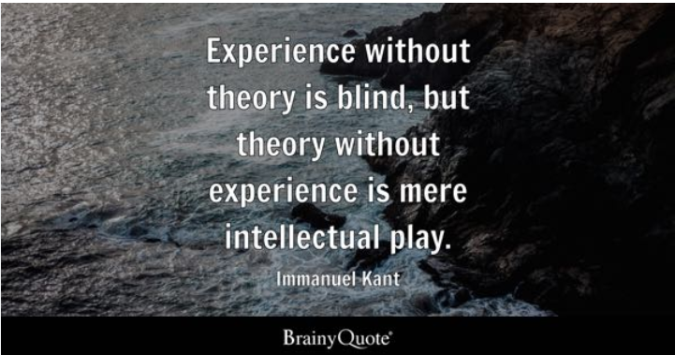

Slide 6
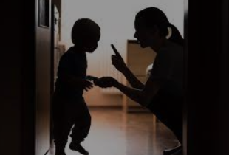


Slide 7
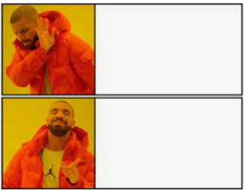
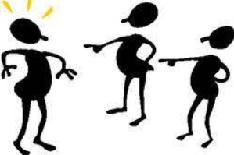
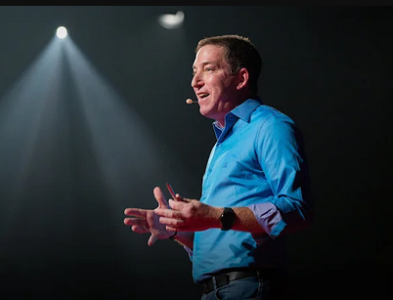
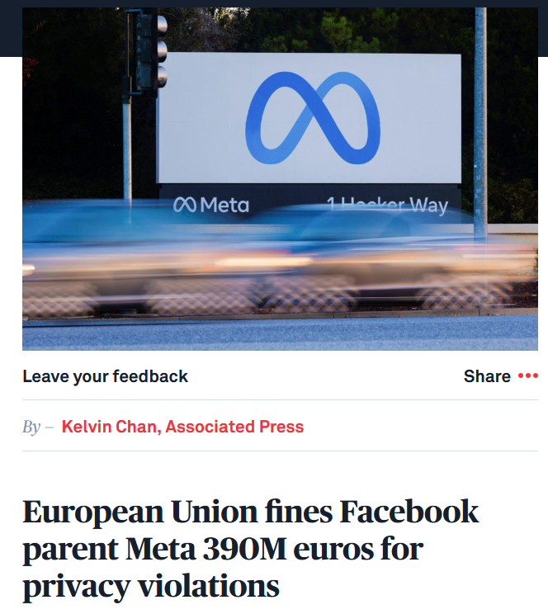
Judging without knowing about topic
Glenn Greenwald: Why privacy matters

Slide 8
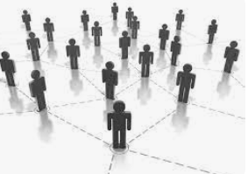
Social Capital
Putnam:
The connections among individuals—social networks and the norms of reciprocity and trustworthiness that arise from them (...slide 7.1…)
What’s the big deal?

Slide 9
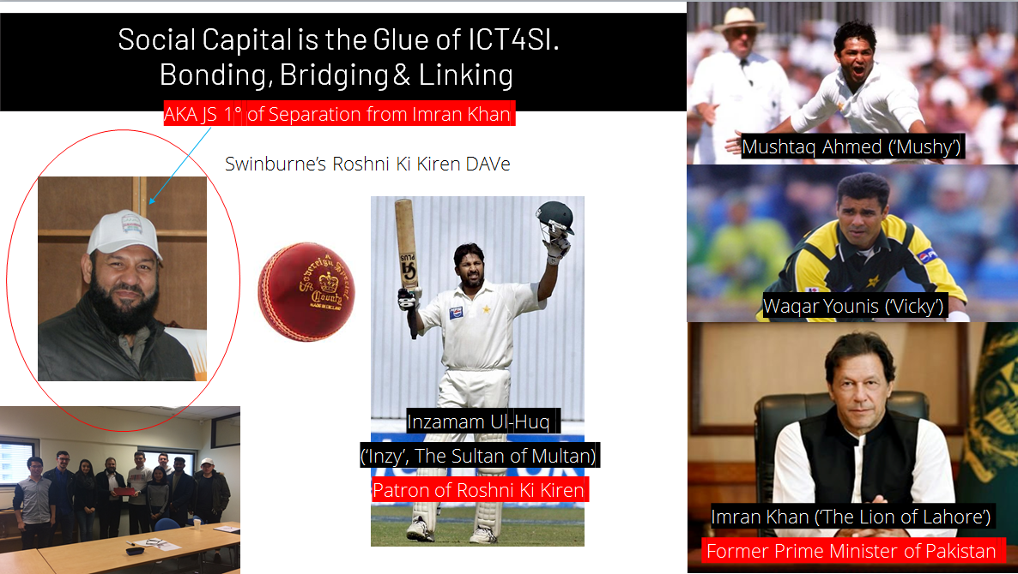

Visible Outcomes of the conversations
Invisible Outcomes of the conversations
Exchange of LinkedIn details
Bond Formation
Exchange of Hidden Information
Oppurtunity

Slide 10
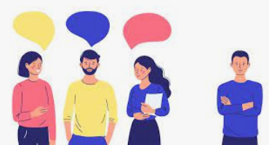


Slide 11
Reference:
—-Make all of them alphabetical ordered and ++ APA7th ++ put in authoor, year in the slide parts if txt
https://www.crowe-associates.co.uk/coaching-tools/gibbs-reflective-cycle/
Slide 4.2–lect slide
https://en.wikipedia.org/wiki/Ann_Cavoukian
https://www.torontomu.ca/pbdce/about/ann-cavoukian/
https://www2.deloitte.com/content/dam/Deloitte/ca/Documents/risk/ca-en-ers-privacy-by-design-brochure.PDF)
(https://ethyca.com/about-privacy-by-design),
https://www.oaic.gov.au/privacy/privacy-guidance-for-organisations-and-government-agencies/privacy-impact-assessments/privacy-by-design)
https://www.brainyquote.com/quotes/immanuel_kant_121324
https://www.youtube.com/watch?v=pcSlowAhvUk&pp=ygUTdGVkIHRhbGsgb24gcHJpdmFjeQ%3D%3D
https://www.pbs.org/newshour/world/european-union-fines-facebook-parent-meta-390m-euros-for-privacy-violations
https://www.google.com/imgres?imgurl=https%3A%2F%2Fimageio.forbes.com%2Fblogs-images%2Fcognitiveworld%2Ffiles%2F2018%2F08%2Fprivacy-Google-Drive.jpg%3Fheight%3D546%26width%3D711%26fit%3Dbounds&tbnid=pIUP8DPAgCAZlM&vet=12ahUKEwiC7pffn5T_AhW2tGMGHfL6DpcQMygAegQIARBG..i&imgrefurl=https%3A%2F%2Fwww.forbes.com%2Fsites%2Fcognitiveworld%2F2018%2F08%2F13%2Fwill-privacy-first-be-the-new-normal-an-interview-with-privacy-guru-ann-cavoukian%2F&docid=0agMc1zKxbRFpM&w=710&h=546&itg=1&q=Ann%20Cavoukian%20quotes%20on%20privacy&client=firefox-b-d&ved=2ahUKEwiC7pffn5T_AhW2tGMGHfL6DpcQMygAegQIARBG
https://www.oaic.gov.au/privacy/your-privacy-rights/your-personal-information/what-is-privacy
https://www.investopedia.com/terms/d/diffusion-of-innovations-theory.asp
Lect 7.1 social capital slide 8..
https://practice.do/blog/benefits-of-communication-skills

